Slide 1
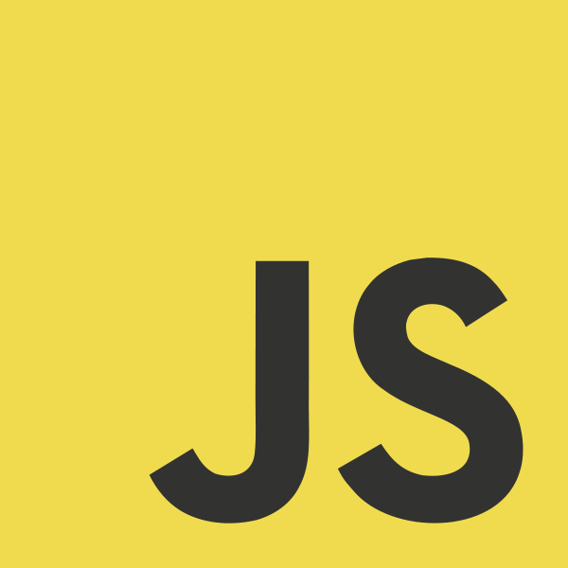
JavaScript Introduction

Slide 2
What is JavaScript?
JavaScript is a dynamic computer programming language.
Dynamic programming language is a class of high-level programming languages which, at runtime, execute many common programming behaviors that static programming languages perform during compilation.
Dynamic languages can be (but not always) frequently referred to as "scripting languages“.
Executed client-side, by the user's web browser.
As opposed to server-side (on the web server).
Like many dynamic languages JavaScript is dynamically typed.
Duck Typing. It means that rather than checking a tag to see whether a value has the correct general type to be used in some way, the runtime system merely checks that it supports all of the operations performed on it.
JavaScript is untyped.
JavaScript is not part of the Java platform.
They were created by completely different people and are not directly related.

Slide 3
Use in web pages
Loading new page content or submitting data to the (for example, a social network might allow the user to post status updates without leaving the page).
Animation of page elements, fading them in and out, resizing them, moving them, etc.
Interactive content, for example games, and playing audio and video.
Validating input values of a web form to make sure that they are acceptable before being submitted to the server.
Transmitting information about the user's reading habits and browsing activities to various websites. Web pages frequently do this for web analytics, ad tracking, personalization or other purposes.

Slide 4
Limitations of Client-Side Scripting
Since script code is embedded in the page, it is viewable to the world.
For security reasons, scripts are limited in what they can do.
e.g., can't access the client's hard drive
Since designed to run on any machine platform, scripts do not contain platform specific commands.
Script languages are not full-featured
e.g., JavaScript objects are crude, not good for large project development

Slide 5
JavaScript is Case Sensitive
JavaScript is case sensitive.
Watch your capitalization closely when you write JavaScript statements:
A function getElementById is not the same as getElementbyID.
A variable named myVariable is not the same as MyVariable.

Slide 6
The <script> Tag
To insert a JavaScript into an HTML page, use the <script> tag.
The <script> and </script> tells where the JavaScript starts and ends.
The lines between the <script> and </script> contain the JavaScript.
You can place an unlimited number of scripts in an HTML document.

Slide 7
Writing to The Document Output
The example below writes <h1> & <p> element directly into the HTML document output:
<!DOCTYPE html>
<html>
<body>
<p>Above</p>
<script>
document.write("<h1>This is a heading</h1>");
document.write("<p>This is a paragraph.</p>");
</script>
<p>Below</p>
</body>
</html>

Slide 8
document.write() Warning
Use document.write() only to write directly into the document output.
If you execute document.write() after the document has finished loading, the entire HTML page will be overwritten:
<!DOCTYPE html>
<html>
<body>
<h1> My First Web Page </h1>
<p> My First Paragraph. </p>
<button onclick="myFunction()">Try it</button>
<script>
function myFunction()
{
document.write(" Oops! The document disappeared! ");
}
</script>
</body>
</html>

Slide 9
Manipulating HTML Elements
To access an HTML element from JavaScript, you can use the document.getElementById(id) method.
Use the "id" attribute to identify the HTML element:
<!DOCTYPE html>
<html>
<body>
<h1>My First Web Page</h1>
<p id="demo">My First Paragraph.</p>
<script>
document.getElementById("demo").innerHTML="My First JavaScript";
</script>
</body>
</html>

Slide 10
Functions and Events
The JavaScript statements, on the previous page, are executed while the page loads.
More often, we want to execute code when an event occurs, like when the user clicks a button.
If we put JavaScript code inside a function, we can call that function when an event occurs.
It is a common practice to put functions in the <head> section, or at the bottom of the page. This way they are all in one place and do not interfere with page content.

Slide 11
Example: Functions and Events
<!DOCTYPE html>
<html>
<head>
<script>
function myFunction()
{
document.getElementById("demo").innerHTML="My First JavaScript Function";
}
</script>
</head>
<body>
<h1>My Web Page</h1>
<p id="demo">A Paragraph.</p>
<button type="button" onclick="myFunction()">Try it</button>
</body>
</html>

Slide 12
External JavaScripts
Scripts can also be placed in external files. External files often contain code to be used by several different web pages.
External JavaScript files have the file extension .js.
To use an external script, point to the .js file in the "src" attribute of the <script> tag:
<!DOCTYPE html> <html> <body> <script src="myScript.js"></script> </body> </html>

Slide 13
Comments
Single-Line:
// Write to a heading: document.getElementById("myH1").innerHTML="Welcome to my Homepage"; // Write to a paragraph: document.getElementById("myP").innerHTML="This is my first paragraph.";
Multi-Line:
/* The code below will write to a heading and to a paragraph, and will represent the start of my homepage: */ document.getElementById("myH1").innerHTML="Welcome to my Homepage"; document.getElementById("myP").innerHTML="This is my first paragraph.";

Slide 14
Variables
You declare JavaScript variables with the var keyword:
var carname="Volvo";
Unlike more strict programming languages JavaScript doesn’t force you to declare the type of variable when you define it.
You can declare many variables in one statement. Just start the statement with var and separate the variables by comma:
var lastname="Doe", age=30, job="carpenter";
Variable declared without a value will have the value undefined.
If you re-declare a JavaScript variable, it will not lose its value.

Slide 15
Data Types
JavaScript has dynamic types. This means that the same variable can be used as different types:
var x; // Now x is undefined var x = 5; // Now x is a Number var x = "John"; // Now x is a String
Variables may contain values of the following types: Number, String, Boolean, Null

Slide 16
Numbers
JavaScript has only one type of number. Numbers can be written with, or without decimals:
var x1=34.00; // Written with decimals var x2=34; // Written without decimals
Extra large or extra small numbers can be written with scientific (exponential) notation:
var y=123e5; // 12300000 var z=123e-5; // 0.00123

Slide 17
Strings
A string can be any text inside quotes. You can use single or double quotes:
var carname="Volvo XC60"; var carname='Volvo XC60';
You can use quotes inside a string, as long as they don't match the quotes surrounding the string:
var answer="It's alright"; var answer="He is called 'Johnny'"; var answer='He is called "Johnny"';

Slide 18
Boolean
Booleans can only have two values: true or false.
var x=true; var y=false;

Slide 19
Undefined and Null
Undefined is the value of a variable with no value.
Variables can be emptied by setting the value to null;
cars=null;

Slide 20
Functions
A function is a block of code that will be executed when "someone" calls it.
A function is written as a code block (inside curly { } braces), preceded by the function keyword.
If you assign a value to a variable that has not yet been declared, the variable will automatically be declared as a GLOBAL variable.
<!DOCTYPE html> <html> <head> <script> function myFunction() { alert("Hello World!"); } </script> </head> <body> <button onclick="myFunction()">Try it</button> </body> </html>

Slide 21
Calling a Function with Arguments
A function in JavaScript is always pass by value, but for objects the value of the variable is a reference.
<!DOCTYPE html>
<html>
<body>
<p>Click one of the buttons to call a function with arguments</p>
<button onclick="myFunction('Bob','Builder')">Click for Bob</button>
<script>
function myFunction(name,job)
{
alert("Welcome " + name + ", the " + job);
}
</script>
</body>
</html>

Slide 22
== vs ===
equality operator ==, the interpreter implicitly tries to convert the values before comparing.
function myFunction()
{
var x=5;
document.getElementById("demo").innerHTML=x=="5"; //returns true
}
identity operator ===, does not convert the values when comparing.
function myFunction()
{
var x=5;
document.getElementById("demo").innerHTML=x==="5"; //returns false
}

